Slide 1
June 2022
CHEM SKILL DEVELOPMENT CENTRE
Industry Oriented Knowledge Programme

Slide 2
CHEM SKILL DEVELOPMENT CENTRE (CSDC)
An Initiative promoted by 3 Industry Associations
Chemical Industries Association (CIA)
Indian Chemical Council (ICC) and
Manali Industries Association (MIA)
To Bridge the Gap between Theory and Practice

Slide 3
CSDC OBJECTIVES
The Programme helps Students to be more employable
To provide practical knowledge to the students
To build confidence and to be competitive
To understand Industry and the practices
To understand the expectations from the Industry
To impress about safe practices and social obligations such as environmental compliance
To develop students to become world class engineers

Slide 4
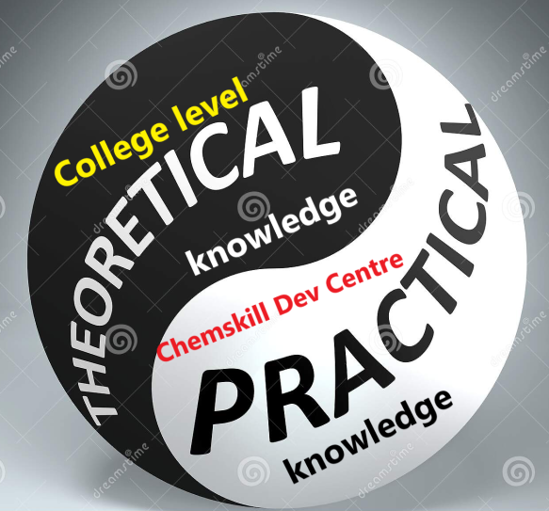
STRATEGY and APPROACH
The programme is designed to
Compliment Theoretical Knowledge with Practical Applications
Impart Additional Knowledge and Skills not part of Academic Curriculum

Slide 5
METHODOLOGY
ONLINE CLASSES
3 Weeks programme
Each day : 3 topics 90 Minutes each
By Faculty team with decades of Industry experience
Practical Training in a Chemical Plant
for Ten Days

Slide 6
KEY DIFFERENTIATORS
The Only programme by Experienced Faculty from Chemical Industry
First of its kind in the Indian Chemical Industry

Slide 7
Programme Content
Over view of chemical industry
Life cycle of chemical Plant
Plant Design:
International Standards
Momentum transfer
Heat transfer
Boilers & Fired heaters
Pressure vessels & storage tanks
Safety Aspects during designs stage
Process drawings & documents
Industrial utilities
Operational control practices
Operation of chemical Plants
Logistics
Technical services
Asset Integrity
Quality control lab
Process monitoring & improvements
Safe practices in chemical Plant
Risk management

Slide 8
Spill control & containment
HAZOP & SIL
Simulation
EIA & QRA
Pollution monitoring & control
Environmental regulations
Project management
Renewable energy
Case studies & problem solving
Industry 4.0
Entrepreneurship
Economics of production
TPM & responsible care
Corporate career challenges
Career path & employment opportunities
College to corporate transformation

Slide 9
Profile of Faculty Members
Decades of experience in
Refining
Petrochemicals
Fertilizers
Design
Consultancy
Project management
General management
Energy management
Safety systems
Environmental management

Slide 10
CSDC PROGRAMMES DONE SO FAR
Covered ~ 200 Fresh Engineers in 5 batches since Sep 2021
Separate Training Programs covering 70 already Employed Engineers in the Chemical Industries with additional knowledge

Slide 11
Feedback
Feedback from participants after each session is positive endorsing the programme content
Feedback from those employed after CSDC training has confirmed
Better performance during interview
Better positioning among the team

Slide 12
In the Horizon
Programmes for Chem Technology diploma Students
Programmes for Non-Chemical Engineers aspiring to join chemical industry
Programme on Quality and Analytical Courses for Science Stream Students

Slide 13
CSDC is well positioned for transforming the students from
Institution to Industry
By Judicious blend of lectures and in-plant training
For enrolling , please contact
Ph. No.+91 44-24420579
Mobile: +91 98846 42787
chemindassn2019@gmail.com

